Slide 1


D. Y. Patil Technical Campus, Faculty of Engineering & Faculty of Management, Talsande.
Department of Computer Science & Engineering
Domain Specific Maga Project Presentation
Team Members.
Guide.
Lalit Khekale (Team Leader)
Kshitija Thorat
Dipeeka Jadhav
Tanishq Pandharpatte
Jasmin Shaikh Mam
1

Slide 2


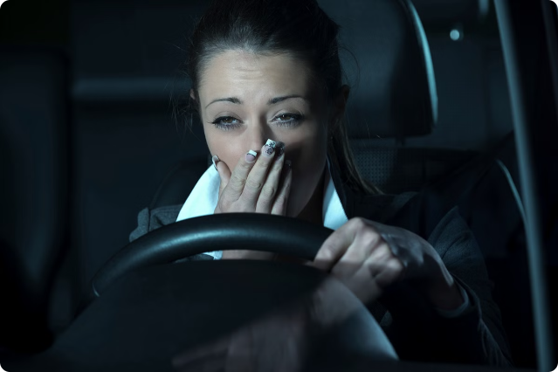
D. Y. PATIL , TECHNICAL CAMPUS , FACULTY OF ENGINEERING, TALSANDE
sounddevice
Introduction to
Driver drowsiness
Detection System
Driver drowsiness is a major safety concern, contributing to numerous accidents each year. This system uses advanced camera and algorithmic technology to monitor a driver's facial expressions and eye movements, detecting signs of drowsiness and alerting the driver to prevent potential crashes.
2

Slide 3

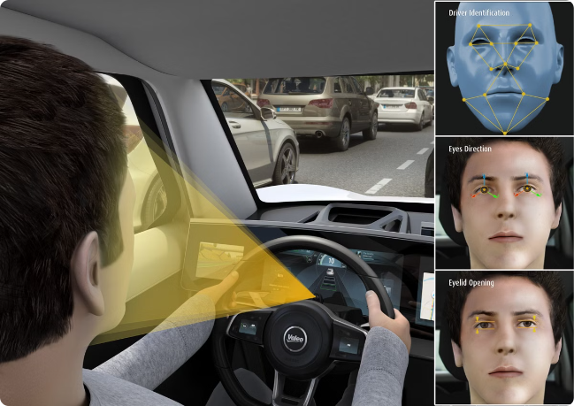
D. Y. PATIL , TECHNICAL CAMPUS , FACULTY OF ENGINEERING, TALSANDE
Key Components and Objectives
Camera
Mounted on the dashboard, the camera continuously monitors the driver's face and eyes.
Detection Algorithms
Advanced algorithms analyze eye blink patterns and head movements to determine drowsiness levels.
Alert System
When drowsiness is detected, the system triggers audible, visual, and mobile alerts to wake the driver.
3

Slide 4
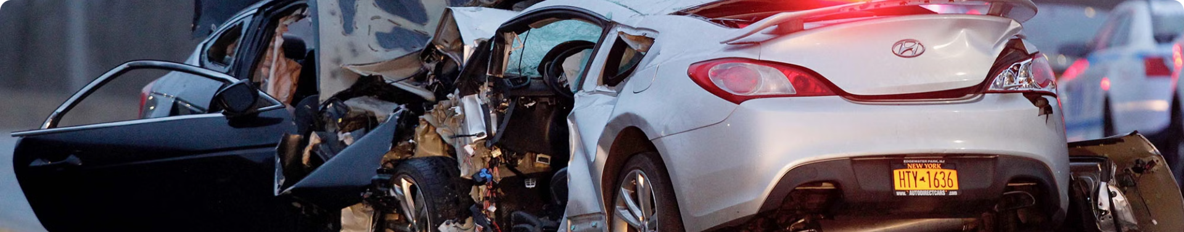
D. Y. PATIL , TECHNICAL CAMPUS , FACULTY OF ENGINEERING, TALSANDE
Problem Statement
1
Drowsy Driving Risks
2
Detecting Drowsiness
3
Timely Alerts
Drowsy driving can lead to impaired reaction times, reduced awareness, and increased risk of accidents.
Identifying signs of drowsiness, such as eye closures and head nodding, is crucial to preventing crashes.
Providing immediate, effective alerts to wake the driver can make the difference between a safe journey and a tragic incident.
4

Slide 5
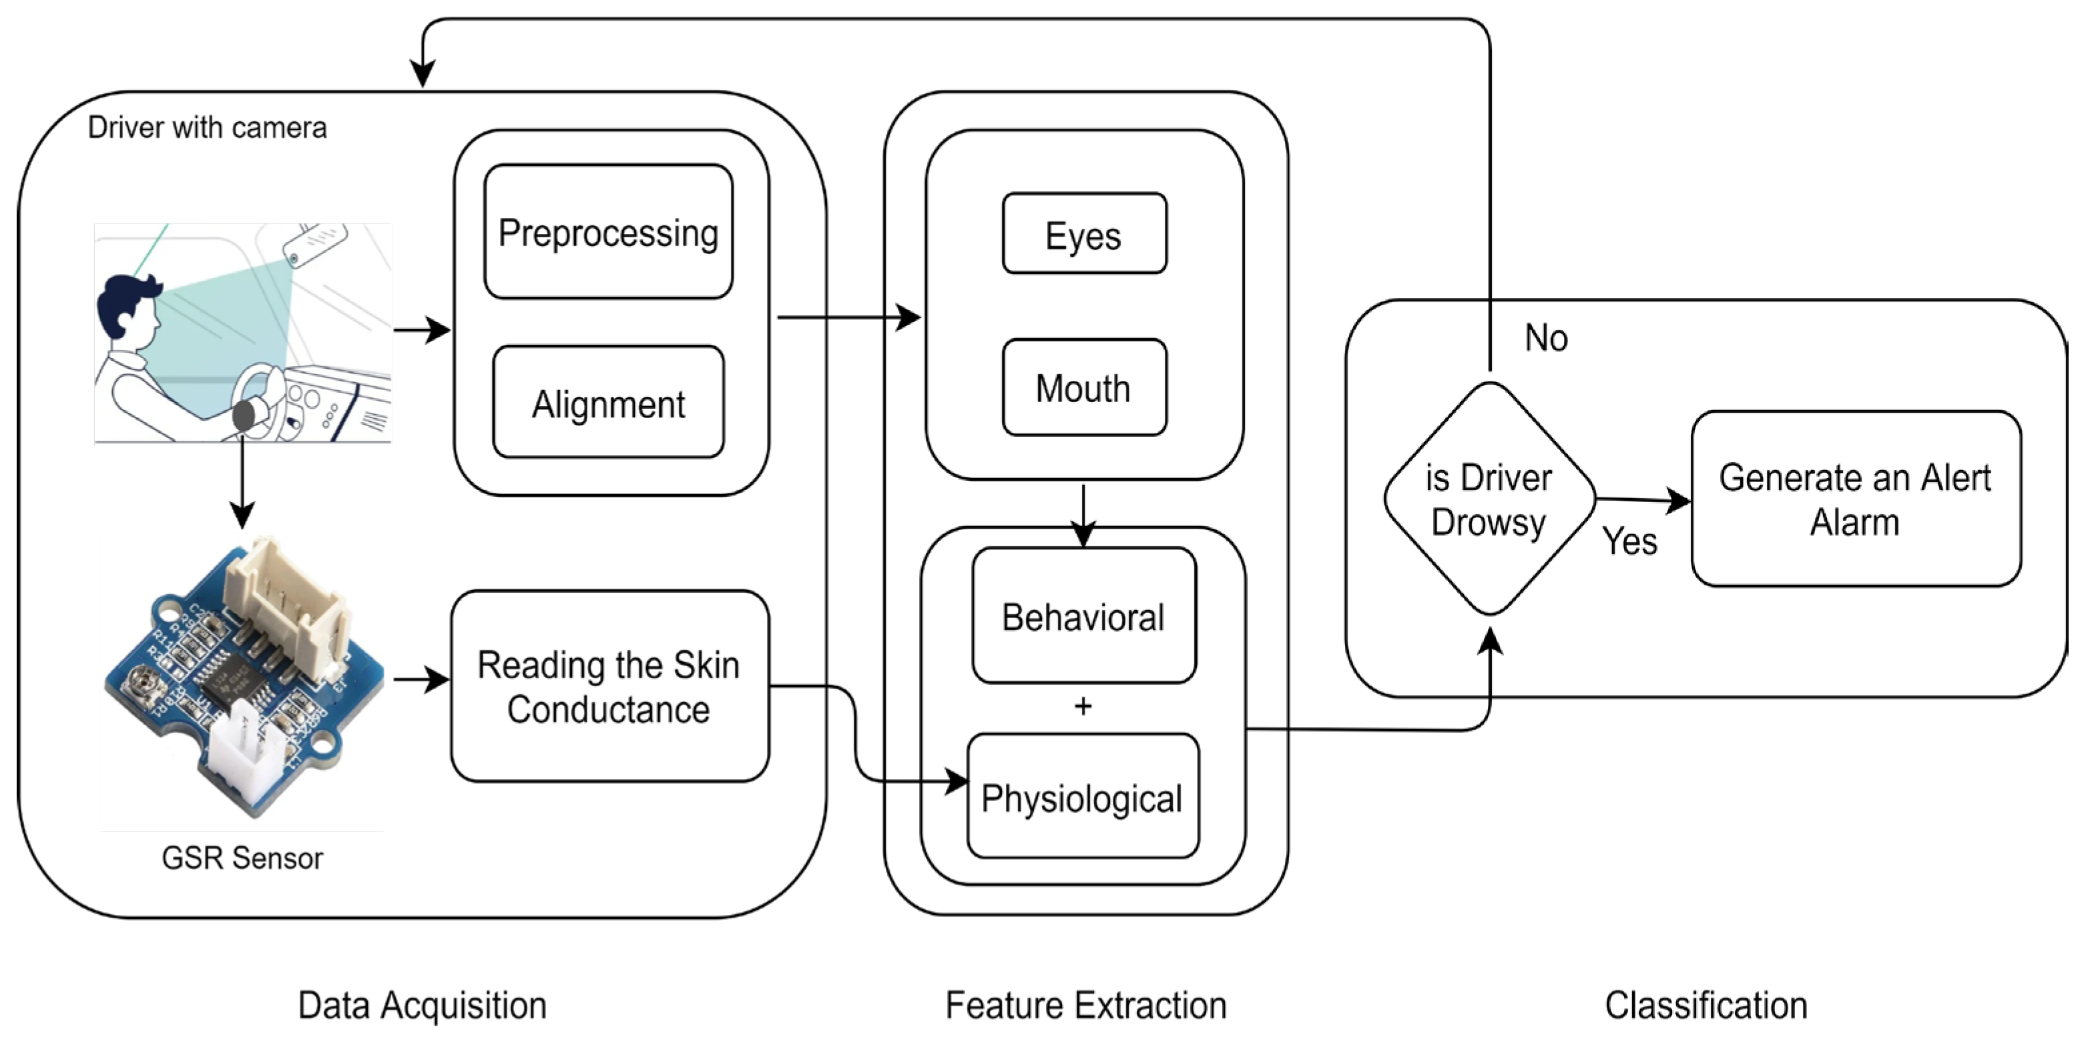
D. Y. PATIL , TECHNICAL CAMPUS , FACULTY OF ENGINEERING, TALSANDE
Architecture
Hardware
Software
Integration
Includes the dashboard-mounted camera and connected alert systems (speakers, display, mobile integration).
Comprises the drowsiness detection algorithms, data processing, and alert triggering logic.
Seamless combination of hardware and software components for real-time drowsiness monitoring and alerts.
5

Slide 6

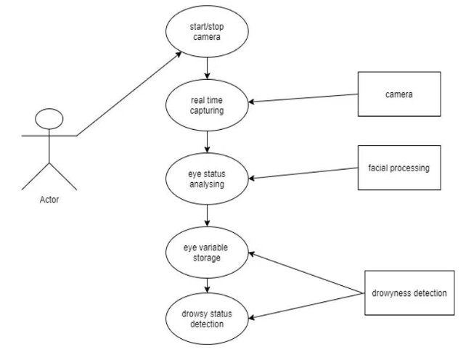
D. Y. PATIL , TECHNICAL CAMPUS , FACULTY OF ENGINEERING, TALSANDE
User Interface
1
Face Monitoring
The camera continuously tracks the driver's facial features and eye movements.
2
Drowsiness Analysis
Algorithms assess the data to determine the driver's level of drowsiness.
3
Alert Triggering
When drowsiness is detected, the system activates audible, visual, and mobile alerts.
6

Slide 7
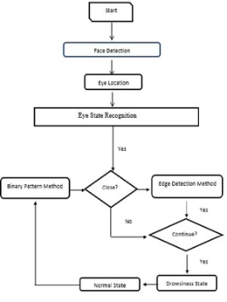
D. Y. PATIL , TECHNICAL CAMPUS , FACULTY OF ENGINEERING, TALSANDE
Block Diagram
Start: The process begins with the detection of a face in an image.
Eye Location: Once a face is detected, the eyes are located within the image.
Eye State Recognition: The state of the eyes (open or closed) is determined using one of two methods:
Binary Pattern Method: This method analyzes the pattern of the eye region to determine if it's open or closed.
Edge Detection Method: This method identifies the edges of the eye to determine if it's open or closed.
Drowsiness State: If the person's eyes are consistently closed for a set period of time, the state is identified as drowsiness.
Drowsiness Detection: If the eyes are detected as closed, the process checks if the person has been detected as drowsy continuously for a certain duration.
Normal State: If the person's eyes are open or they haven't been detected as drowsy for a certain duration, the state is identified as normal.
7

Slide 8


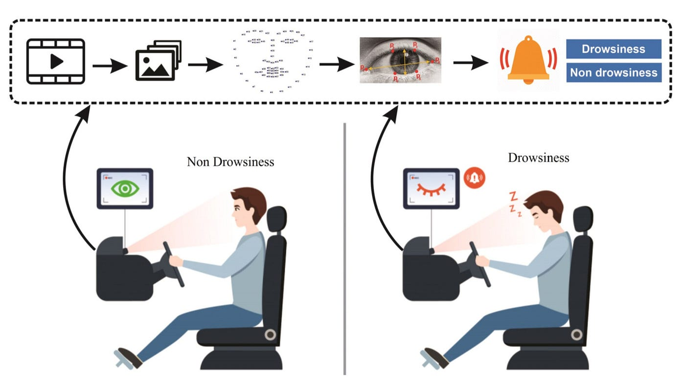






D. Y. PATIL , TECHNICAL CAMPUS , FACULTY OF ENGINEERING, TALSANDE
Technical Tools
OpenCV (`cv2`)
Computer vision library for real-time image processing.
dlib
Machine learning library primarily used for real-time face detection and face landmark prediction.
imutils
Convenience functions for image processing and computer vision tasks.
Scipy (`scipy.spatial.distance`)
Scientific computing library, used here for calculating Euclidean distance.
Twilio
Cloud communications platform for sending SMS.
sounddevice
Library for audio playback and recording.
8

Slide 9


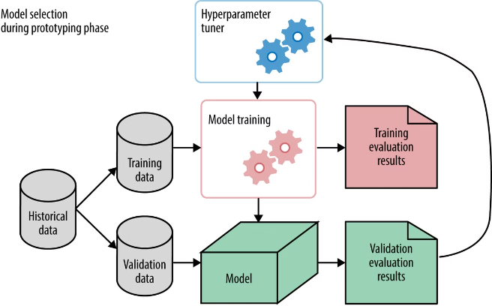



D. Y. PATIL , TECHNICAL CAMPUS , FACULTY OF ENGINEERING, TALSANDE
The Detection Model
Data Collection
Gather a dataset of driver facial expressions and eye movements.
Model Training
Use machine learning algorithms to train the drowsiness detection model.
Accuracy Validation
Test the model's performance and refine it to achieve high accuracy.
Real-time Deployment
Integrate the trained model into the system for live drowsiness monitoring.
9

Slide 10

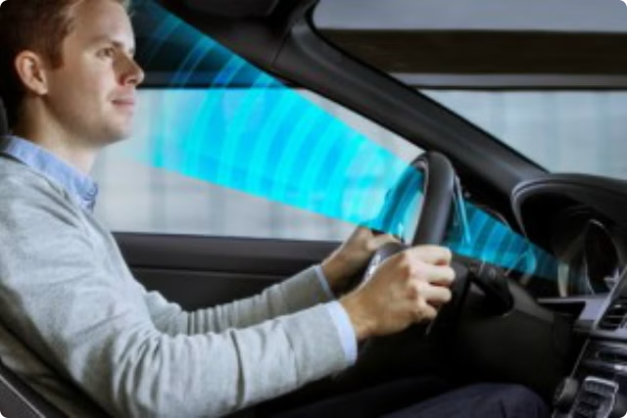
D. Y. PATIL , TECHNICAL CAMPUS , FACULTY OF ENGINEERING, TALSANDE
Implementation in Vehicles
Hardware Integration
The camera and alert systems are seamlessly installed in the vehicle's dashboard.
Software Configuration
The drowsiness detection algorithms are integrated with the vehicle's onboard computer.
Calibration and Testing
The system is calibrated to the driver's unique facial features and thoroughly tested.
Continuous Monitoring
The system runs continuously, monitoring the driver and issuing alerts as needed.
10

